Slide 1
Quantum Computing Introduction* Innovation Lab – 20/02/2023 * from layman’s 2 week training notes

Slide 2
Notices
Things we keep in mind before reading further.
Only important general messages from the course will be presented.
Some technical concepts such as physical mechanics, etc, which is one of the main objective of the course, will not be presented.
The concepts shared in this presentation are from the materials of Quantum Computing Expert given in the course.
The materials of references will be also attached so that you can read the original version.
My interpretation from what he explained (orally, not in the slide) will be in italic blue.
I don’t use complementary resources as well as try to avoid any extra-interpretation. The idea is to summary the information the purest possible in minizing my personal bias in the topic
But the order as well as the name of each slide are my way of telling the story, not ones given in the course
Any errors are mine, the doc is for illustration purposes only

Slide 3
Content
Quantum Computing (QC): 4 WH Questions
Why do we need QC ? => improvement of Algorithm Speed & Solution Quality
What is QC? A quick intro & comparison with classical computing
How to make & use Quantum Processor Unit (QPU): Hardware Approaches
When does the magic of QC happen & what are things we can do now?
Concrete Application of QC:
(non-exhaustive list, all examples here are implemented with Pasqal QPU)
Acceleration (exponential or quadratic) of classical algorithm: QUBO
Quantum Machine Learning
Non-linear differential equation solver
Annex: Information & extra-resources

Slide 4
4 WH Questions
Why ?
What ?
How ?
When ?

Slide 5
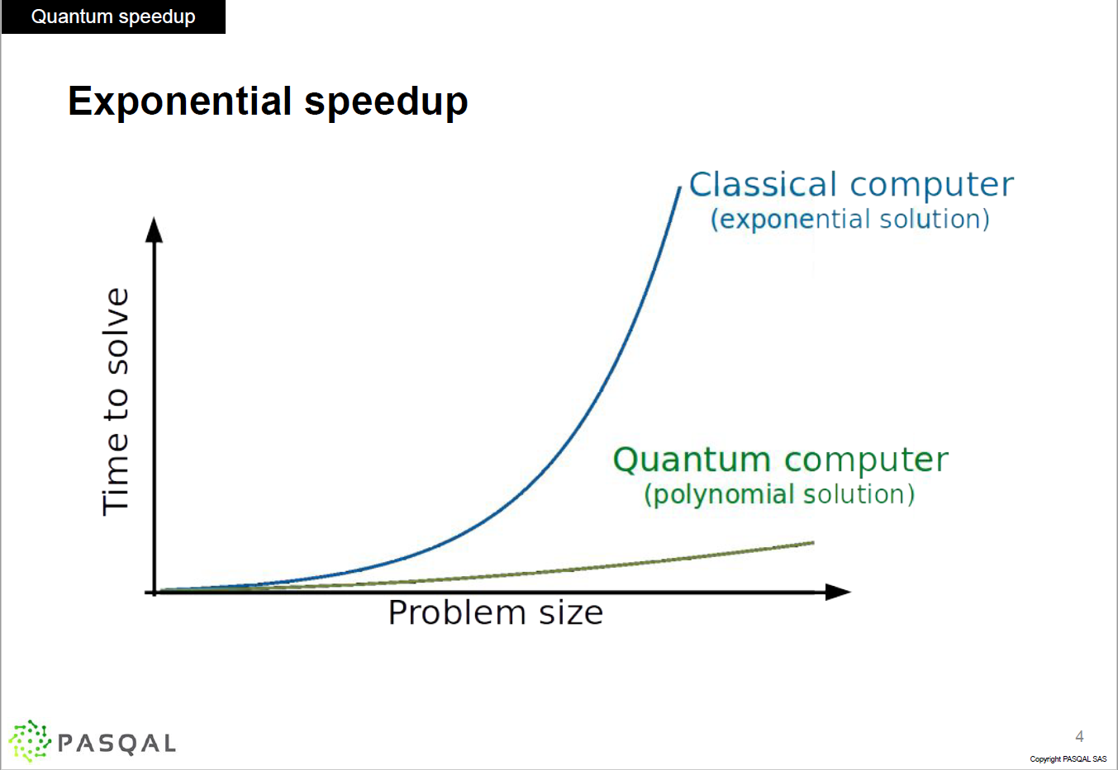
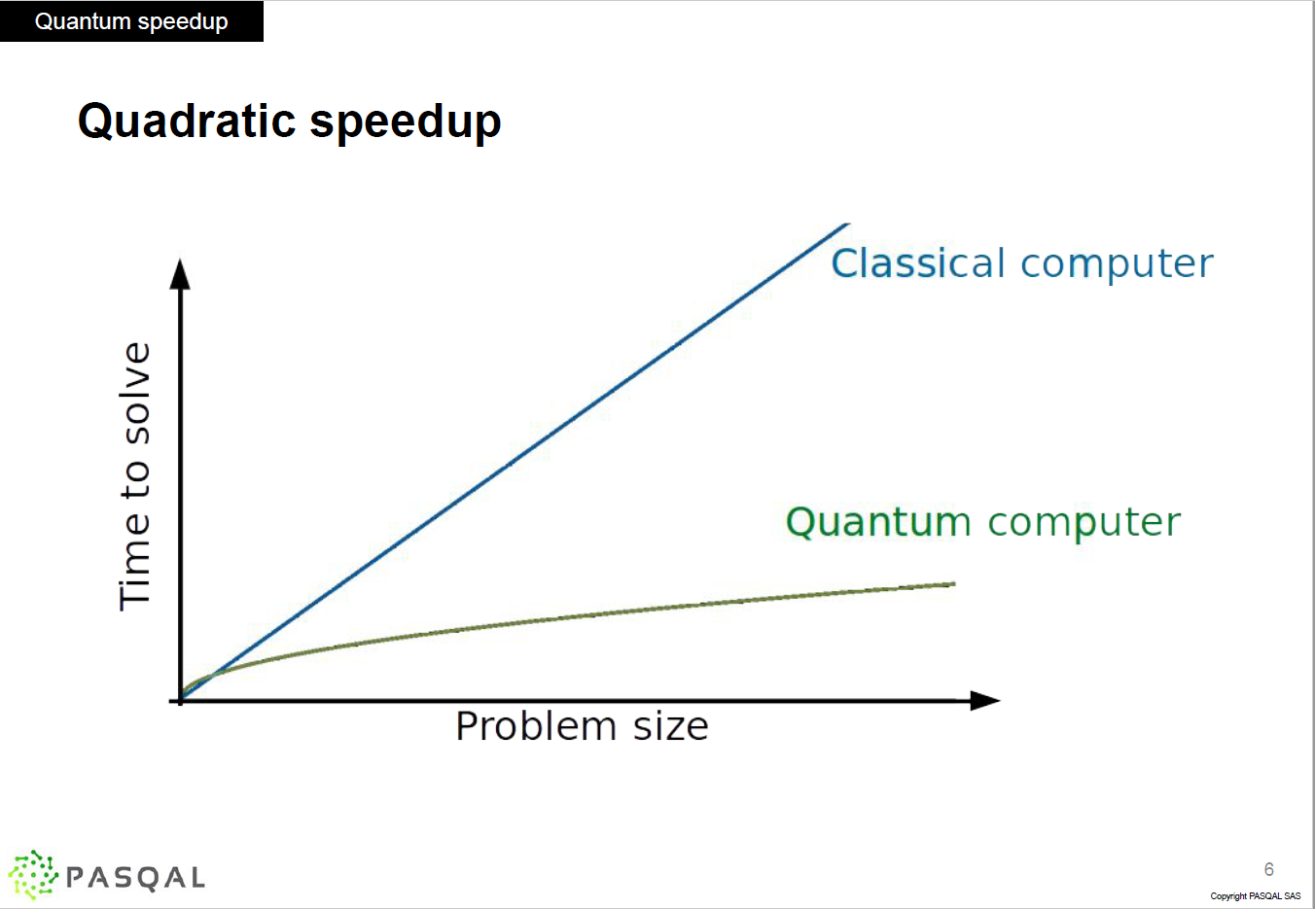
Quantum Computing
Why ?
What ?
How ?
When ?
To solve what classical computing can’t:
A large problem: such as Combinatory Optimization
A complex problem: extremely hard to solve, but can be modelized naturally using a quantum system
Quantum Computing Advantage:
In some problems, we achieve exponential speed-up and quadratic speed-up in others.
Parallelization is not the reason of the speedup (as communicated in public press). It’s the nature of behavior of objects in quantum physic world.
Quantum Computing is not a replacement of classical computing (CPU/GPU). Quantum mechanics gives us an alternative way of design computer & algo to solve certain problems that classical methods can’t.
Hybrid approach = Classical + Quantum

Slide 6
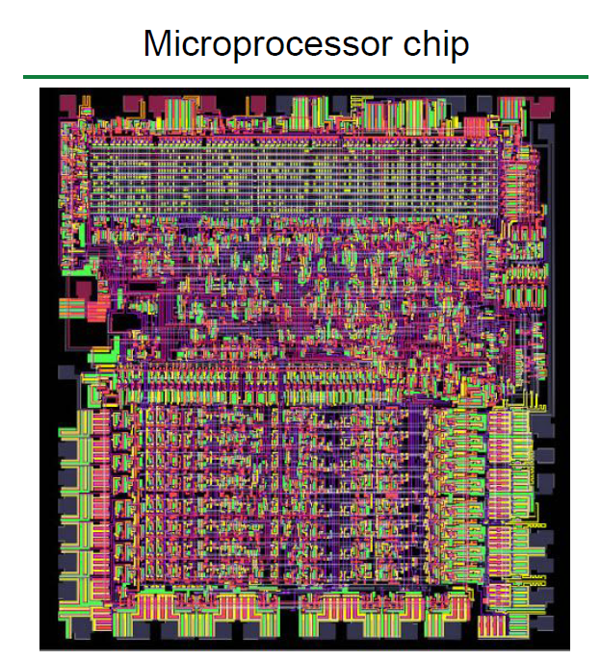
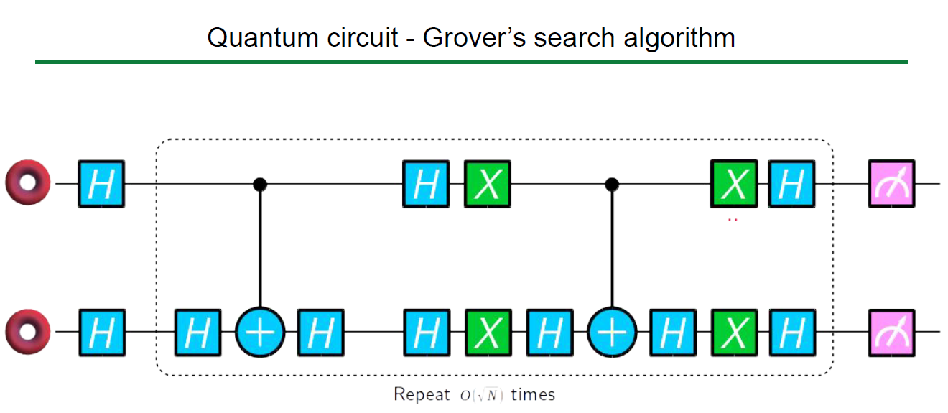
Quantum Computing
Why ?
What ?
How ?
When ?
Processor, Circuits & Bit
Bit (binary digit): smallest unit of data that a computer can process and store
The calculation is on bit with a calculator
Processor (CPU/GPU) = Calculator
Processor = integrated circuits made of billions of transistors
Transitors = physical realization of bits
Circuits: to perform logical operators
Quantum Processor Unit
similar structures with Circuits & Qubits
but with a fundamental change of system: classical to quantum
Example: Circuit to excecute a search algorithm
Circuits
qubits
Final gate:
Measurement
Gate of elementary
operators

Slide 7
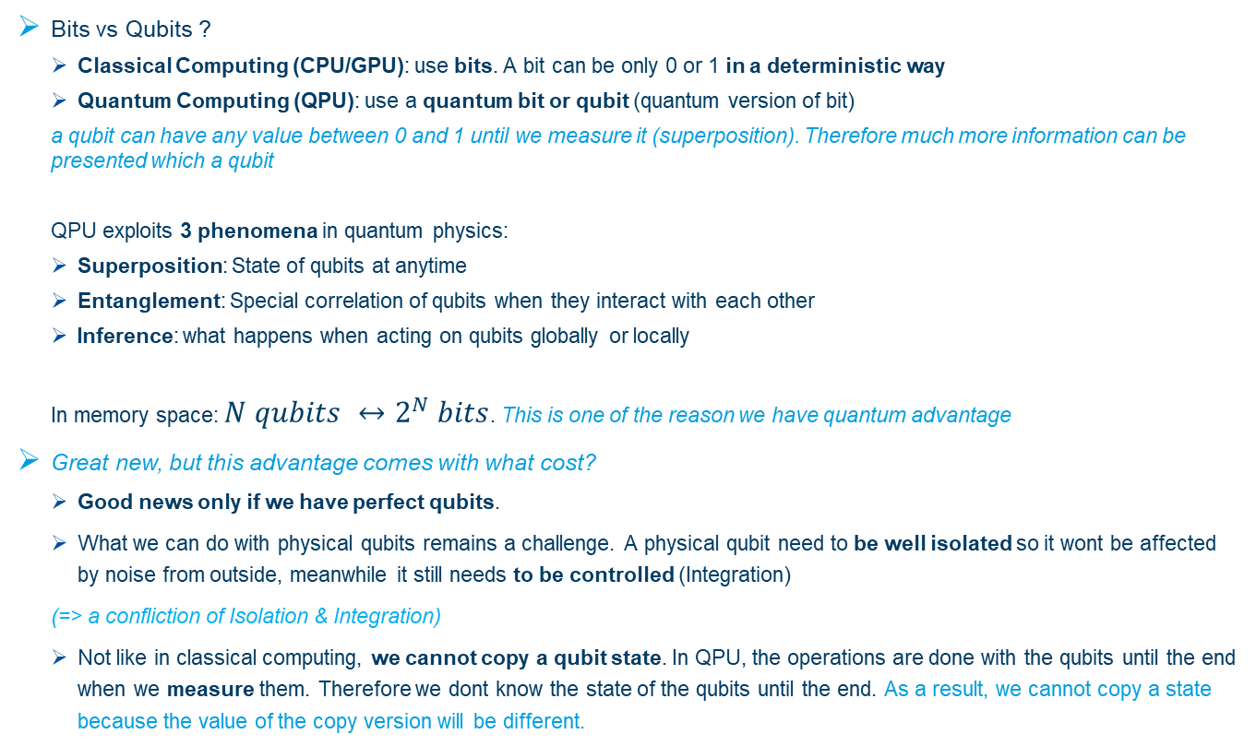
Quantum Computing
Why ?
What ?
How ?
When ?
Bits vs Qubits ?
Classical Computing (CPU/GPU): use bits. A bit can be only 0 or 1 in a deterministic way
Quantum Computing (QPU): use a quantum bit or qubit (quantum version of bit)
a qubit can have any value between 0 and 1 until we measure it (superposition). Therefore much more information can be presented which a qubit
QPU exploits 3 phenomena in quantum physics:
Superposition: State of qubits at anytime
Entanglement: Special correlation of qubits when they interact with each other
Inference: what happens when acting on qubits globally or locally
In memory space: $N qubits ↔2^{N} bits$. This is one of the reason we have quantum advantage
Great new, but this advantage comes with what cost?
Good news only if we have perfect qubits.
What we can do with physical qubits remains a challenge. A physical qubit need to be well isolated so it wont be affected by noise from outside, meanwhile it still needs to be controlled (Integration)
(=> a confliction of Isolation & Integration)
Not like in classical computing, we cannot copy a qubit state. In QPU, the operations are done with the qubits until the end when we measure them. Therefore we dont know the state of the qubits until the end. As a result, we cannot copy a state because the value of the copy version will be different.

Slide 8
Quantum Computing
Why ?
What ?
How ?
When ?
Quantum Computing
Information Theory
Physics
Maths
Orginal Problem
Math Formulation
Quantum Competible Problem
Quantum Formulation
Quantum Algo
Quantum Operators
Hardware
Performing Quantum Operation
Steps of Solving Problem with QC
Quantum Computing is to design:
the hardware - processor (QPU): Knowledge in Physics
the circuits (combination of information gates) to perform the algorithms: Maths + Informatics
the quantum algorithms to solve the problems: Maths
As a result,
Different ways of implementing QPUs => different providers
The operators & algos needed to be quantum compatible
Collaboration of Business Experts & Quantum Experts
Business Experts needs to understand the basics of quantum mechanics

Slide 9
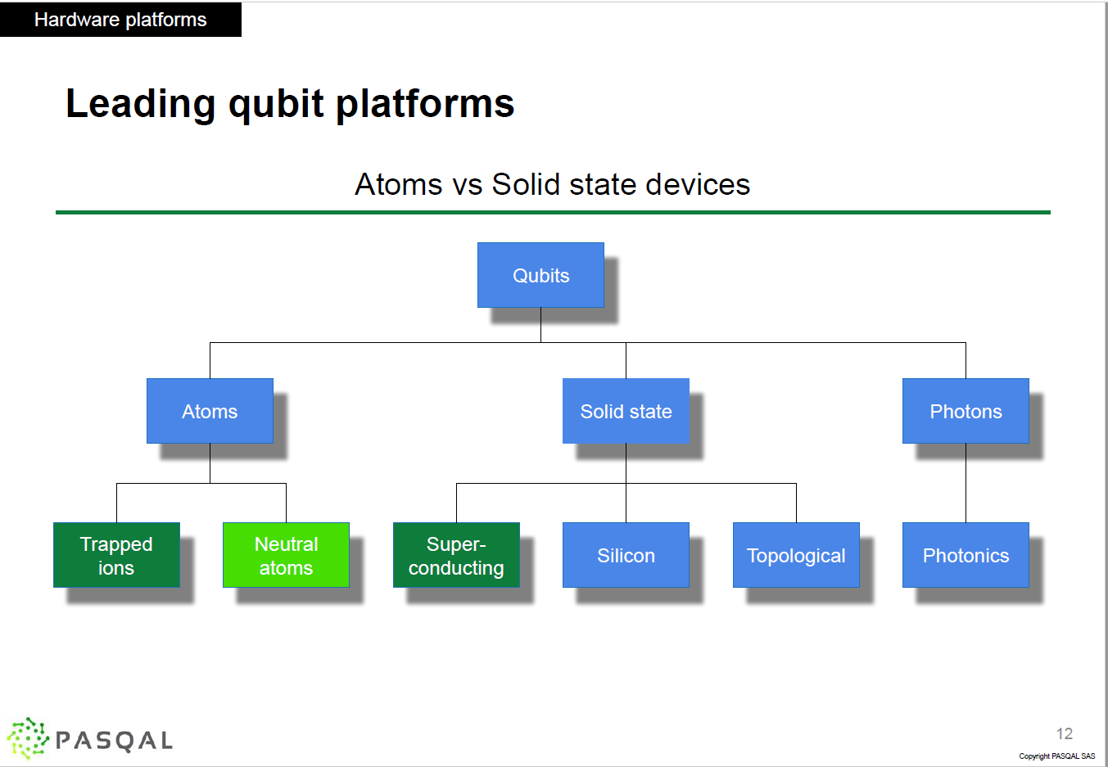
Quantum Computing
Why ?
What ?
How ?
When ?
Different approaches to make QPUs:
University of Innsbruck
Leading Approaches
Pasqal’s QPU
Google, IBM,
Amazon, Oxford, etc

Slide 10
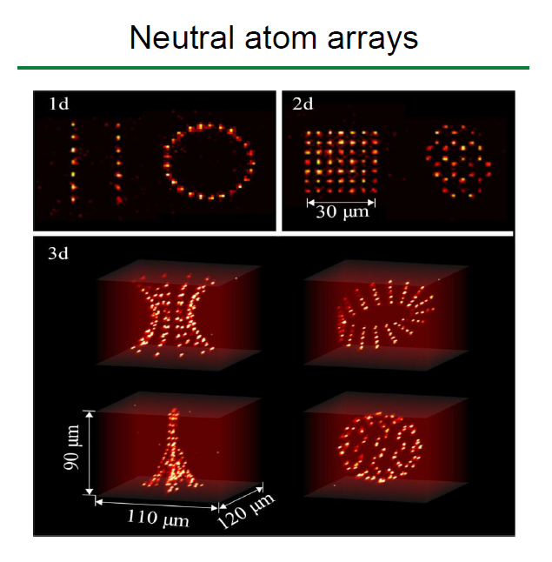
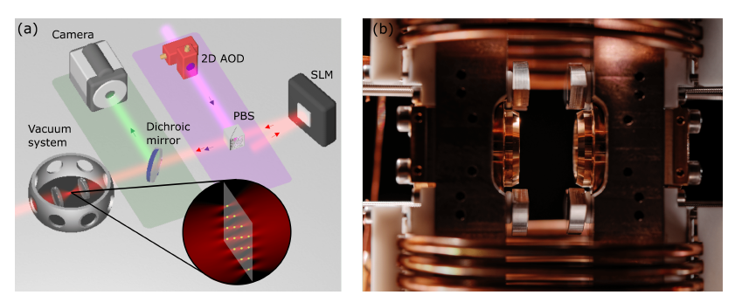
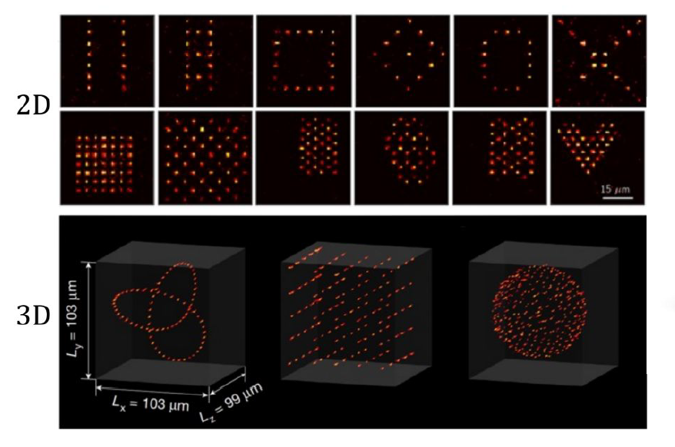
Quantum Computing
Why ?
What ?
How ?
When ?
PASQAL’s Neutral Atoms
1xx qubits – (2023)
A set of lazer beams and camera to control the shape of atoms graphs
This leads to huge advantages of PASQUAL:
The system constructed in demand
Physically matched with the structure of problem
Can do both digital & analog

Slide 11
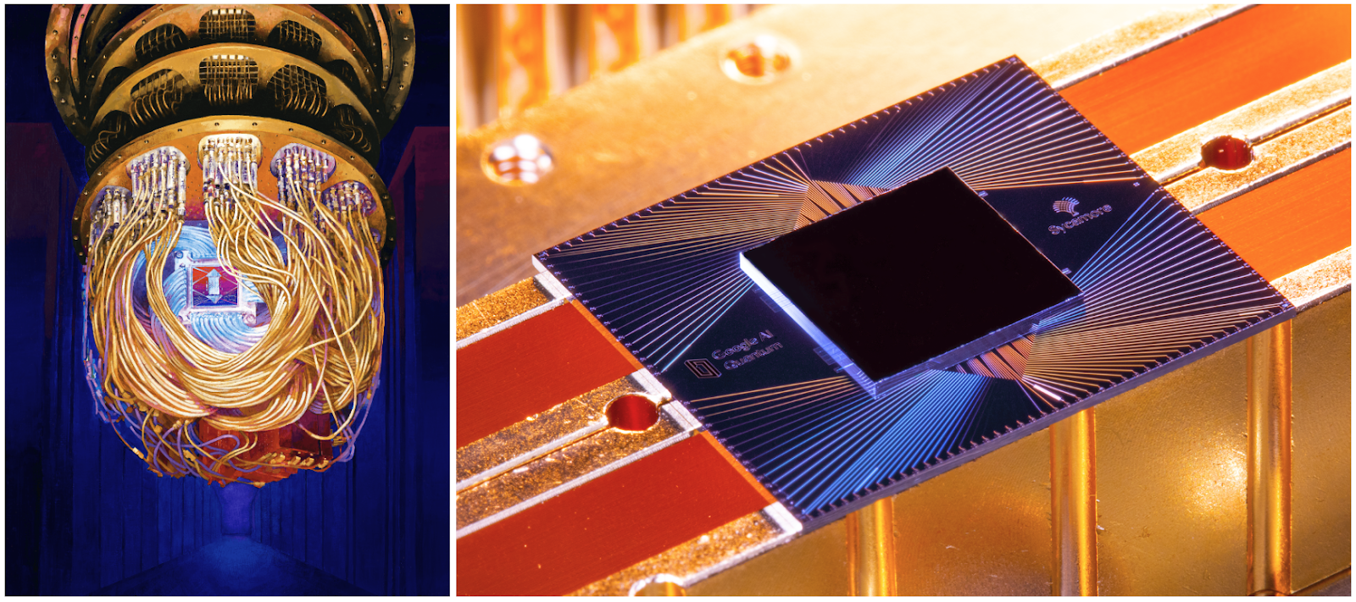
Quantum Computing
Why ?
What ?
How ?
When ?
Super-conducting Approach: Google’s Sycamore 54 qubits (2019)

Slide 12
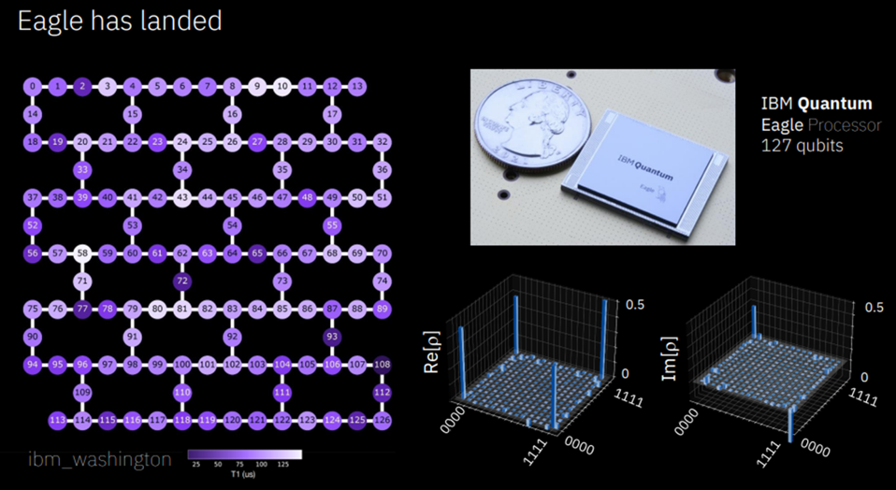
Quantum Computing
Why ?
What ?
How ?
When ?
Super-conducting Approach: IBM’s Eagle QPU 127 qubits (2021)

Slide 13
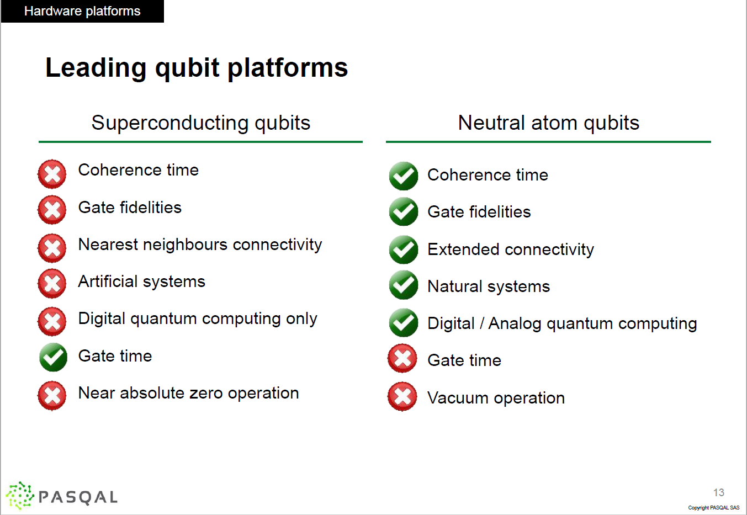
Quantum Computing
Why ?
What ?
How ?
When ?
Pros and Cons of approches:
According to PASQAL:
Their approach is superieur than Superconducting Approach (ones of IBM, Google, AMZ)
The can create a hardware that i) matches with the problem on demand and ii) solve local (a.k.a :digital) & global (a.k.a analog) problem
Meanwhile, the superconducting approach can only solve digital problem.
But PASQAL encourages us to see other providers since the solutions are not the same and for now, at the state of 2023, there is no dominant solution.

Slide 14
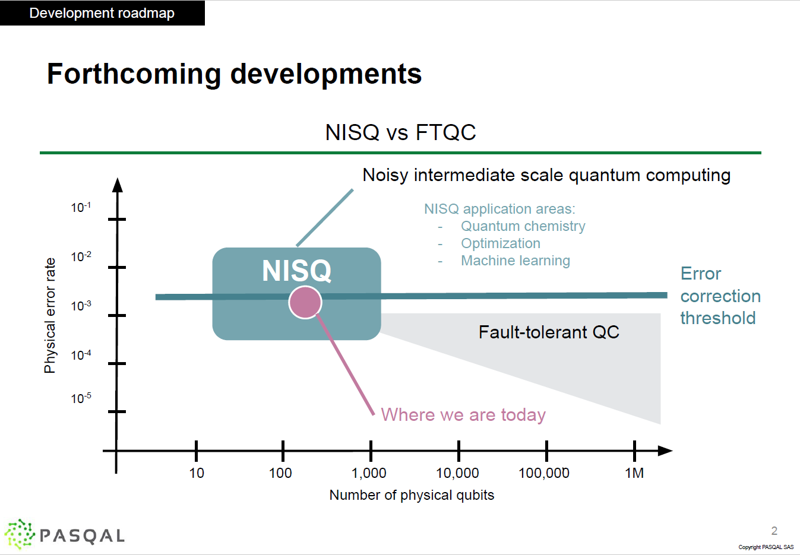
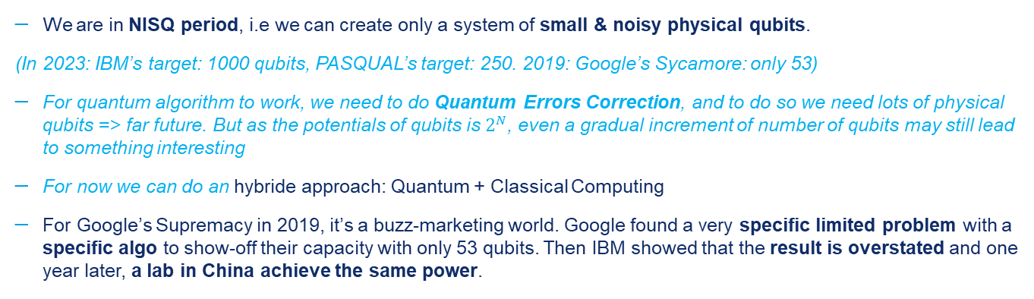
Quantum Computing
Why ?
What ?
How ?
When ?
We are in NISQ period, i.e we can create only a system of small & noisy physical qubits.
(In 2023: IBM’s target: 1000 qubits, PASQUAL’s target: 250. 2019: Google’s Sycamore: only 53)
For quantum algorithm to work, we need to do Quantum Errors Correction, and to do so we need lots of physical qubits => far future. But as the potentials of qubits is $2^{N}$, even a gradual increment of number of qubits may still lead to something interesting
For now we can do an hybride approach: Quantum + Classical Computing
For Google’s Supremacy in 2019, it’s a buzz-marketing world. Google found a very specific limited problem with a specific algo to show-off their capacity with only 53 qubits. Then IBM showed that the result is overstated and one year later, a lab in China achieve the same power.
Depass this threshold is extremely hard physically
Effective zone where we can profit QPU

Slide 15
Concrete Application
Combinatory Optimization:
Quadratic Unconstrained Binary Optimization (QUBO ) Problem
Algorithmic Approach:
Quantum Adiabatic Algorithm (QAA)
Quantum Approximate Optimization Algorithm (QAOA)
Use Case: CACIB Credit Scoring Problem -> Optimizing number of base learners in a meta-learner Qboost to improve explainability & prediction speed.
Quantum Machine Learning
Example: Graph Classification
Ideas: Graph => Graph Kernel Estimation (Kernel based on estimated physical-energetic states) => SVM / Ridge Kernel.
Quantum Solver of nonlinear differential equations
Example: Fluid dynamics – Burger and Navier-Stokes equations
Ideas: Inspired from PINNs (physics informed neural networks), a quantum version

Slide 16
Quantum Computing
What does this means to us?*
*it’s only my very limited points of views
Quantum Inspired Model or more general physics inspired model
Optimization:
Quantum Computing is very usefull for some special optimization problems which have the roots in physical fields such as Graphical Models or Combinatory Optimization (MIP). Especially with analog approach of PASQAL.
Simulation & Diffusion Solver: same reason as in optimization. If the nature of problem is in physics, the QPU will show its advantage.
Algorithms Speedup via Hybride Approach
Parametric Quantum Processor is « fine tuned » with Classical CPU/GPU
Optimization, ML or DL algos may have a great acceleration if we can overlay them with a suitable quantum algorithm
Notices:
As a client, we’re interested in « software » or algos. But since the « quantum programmation » is done at low level of GPU, a strong collaboration of business experts and quantum experts is necessary. Business Experts need to understand Quantum Mechanics at basic level to efficiently link business problem to physical problem.
Quantum algorithm is very different to classical algorithm because of its fundamental change of how we modelize bits

Slide 17
Quadratic Unconstrained Binary Optimization
CACIB’s Prediction Model: https://arxiv.org/abs/2212.03223
Variational Quantum Machine Learning
Context:
Dataset: Credit Scoring from 90K Instance x 150 features of 20 years data on credit ratings
Main Objective: Prediction of Fallen Angel: proba of downgrade of Credit Rating Notes
Sub-objective: AI Explainability
Classical Solution: Random Forest of 1200 trees => good prediction, long to train: 3h on CPU (no info on hardware), long to predict, low explanability
Quantum Solution: Qboost of DT and/or knn: Extra MIP to reduce the number of Trees => slightly improve the prediction, largely reduce the number of trees from 1200 to 50, hence greatly improve AI explanability.
Contribution:
MIP which is NP-Hard, is nature problem in Quantum Computing
With only 60qubits & variational approach, QPU can exploite larger solution space to find better Random Forest Weighting (v.s naive weighting of 1/N), which leads to a smaller, highly optimized solution
Quantum Implementation: It’s hard to implement some type of constraints in QPU. In this case, the authors arrive to bypass this obstacle with intelligent tricks.
Collaboration:
CACIB on business problem
Multiverse, a quantum algo consulting, on transforme classical formulation to quantum formulation
Pasqal: Implementation of quantum problem on their QPU

Slide 18
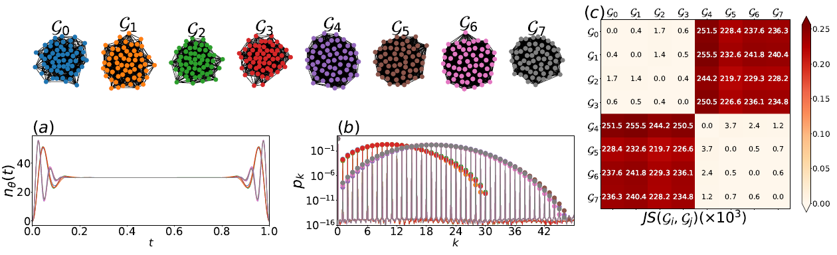
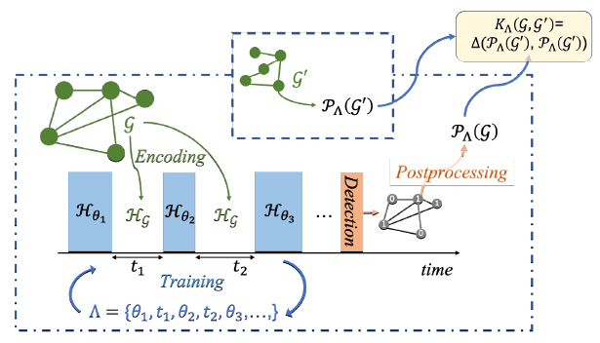
Quantum Machine Learning
Graph Classification: https://arxiv.org/abs/2107.03247
Kernel Estimated after embedding
Input: Graphs
Problem Description
Objective: Classification of Graph
Question: How to do information embedding of Graph properly? Number of Edge, Vertex, etc?
(Analog) Quantum Solution:
Physical implementation of graph with a network of atoms.
Change physical energy of networks => measure the final energy state as kernels
Using kernels in ML algo
Quantum Kernel Estimation

Slide 19
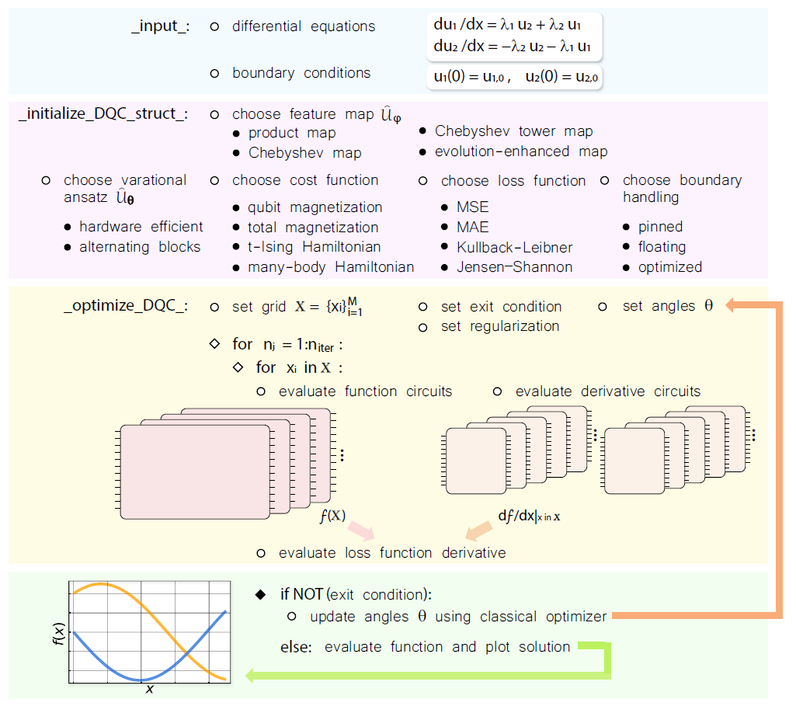
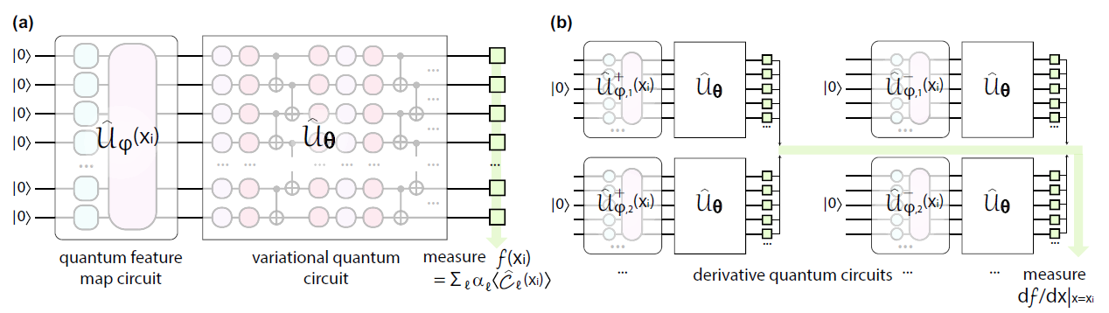
Quantum Non-linear Differential Equation Solver
Fluid dynamics applications: https://arxiv.org/abs/2011.10395
Problem Description:
solving differential equation (Burger’s equation & Navier-Stokes equations)
Quantum Solution:
insprised from PINNs : 3 steps: Feature Mapping -> Itteration (function fitting -> derivation)
Variational Approach

Slide 20
Annex
Extra Information on Pasqal & the lecturer
References & Extra-resources

Slide 21
Some info on PASQAL & the lecturer
Pasqal is founded in 2019 by a group of French Physicists led by Alain Aspect.
Alain Aspect leads a group of researcher in quantum physics since 1992 in Orsay and win Nobel Prize in 2022 for his research.
In 2023, Pasqal raises 100m$ and position in one of the leading approach in Quantum Processor with neutral atom.
They do not only research, but also provides QPU, consulting & training services.
The lecturer of the course worked for IBM before working for Pasqal
Refs:
https://www.pasqal.com/articles/professor-alain-aspect-co-founder-of-pasqal-receives-the-nobel-prize-in-physics-2022
https://www.reuters.com/technology/french-quantum-computer-startup-pasqal-raises-100-million-euros-2023-01-24/

Slide 22
Some more info on Quantum Computing
General:
"Quantum Computing for the Very Curious" : a page-tuner book from MIT that helps you explain QC better than Canadian’s PM (cannot acces from Amundi’s network)
https://quantum.country/qcvc
« France Quantum Conference » : State of the art, & Application by actors on the fields. CACIB will participate in 2023 version
https://www.francequantum.fr/sessions
Technical Training:
Offline:
French College Course on Quantum Mechanics & Application: not MOOCs, free access in June/2023 for who wants to dig deeper in the maths.
https://www.college-de-france.fr/agenda/colloque/machine-learning-in-quantum-sciences
Moocs & University Courses:
Quantum Information Course (KAIST)
https://www.coursera.org/learn/introduction-to-quantum-information
Quantum Optics: Course of Alain Aspect to understand better how Pasqal’s hardware works
https://www.coursera.org/learn/quantum-optics-single-photon
https://www.coursera.org/learn/quantum-optics-two-photons
Quantum Computation (Caltech)
http://theory.caltech.edu/~preskill/ph229/

Slide 23
Some more info on Quantum Computing
Tools:
Emulator to play with QPU with training/ tutorials:
IBM’s toolkit with training course: https://qiskit.org/
Pasqual’s toolkit with documentation:
https://www.pasqal.com/services/pulser-studio
https://pulser.readthedocs.io/en/stable/
Google’s toolkit: Quantum Tensorflow: https://www.tensorflow.org/quantum
Books & Papers:
https://arxiv.org/abs/1611.04471
https://arxiv.org/abs/2107.01218
https://arxiv.org/abs/1804.03719
https://arxiv.org/abs/2107.03247
https://www.amazon.fr/Machine-Learning-Quantum-Computers-Schuld/dp/3030830977
https://link.springer.com/book/10.1007/978-3-030-83274-2
https://www.amazon.com/Quantum-Computation-Information-10th-Anniversary/dp/1107002176
https://scottaaronson.blog/

